Slide 1




A Complete Guide to Programming in C++
Chapter 8– Converting Arithmetic Types

Slide 2

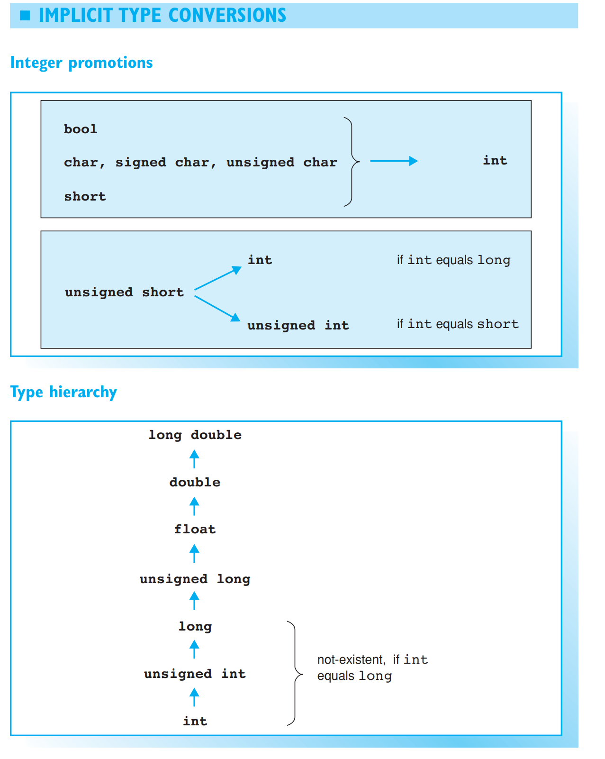

Converting Arithmetic Types
C++ allows you to mix arithmetic types in a single expression — in other words, the operands of an operator can belong to different types. The compiler automatically performs implicit type conversion, where a common type, which allows the operation in question to be performed, is assigned for the values of both operands. You can generally assume that the “smaller” type will be converted to the “larger” type. The assignment operator is an exception to this rule and will be discussed separately.
The result of an arithmetic operation belongs to the common type used to perform the calculation. However, comparison expressions will be bool types no matter what type of operands are involved.

Slide 3
Integer Promotion
Integer promotion is first performed for any expression:
bool, char, signed char, unsigned char, and short are converted to int
unsigned short is also converted to int if the int type is greater than short, and to unsigned int in all other cases.
This type conversion is performed so as to preserve the original values. The boolean value false is converted to 0 and true is converted to 1. Thus, C++ will always use int type values or greater when performing calculations.
Given a char variable c, the values of c and 'a' in the expression c < 'a' will be converted to int before being compared.

Slide 4
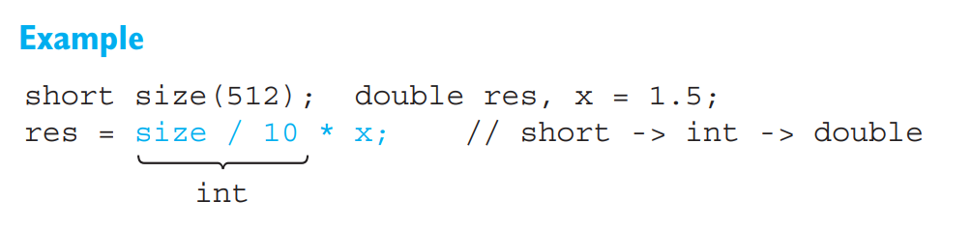
Usual Arithmetic Type Conversions
If operands of different arithmetic types still occur after integer promotion, further implicit type conversions along the lines of the hierarchy on the opposite page will be necessary. In this case, the type of the operand with the highest rank in the hierarchy is applied. These type conversions and integer promotions are collectively known as usual arithmetic type conversions.
In our example, size/10 * x, the value of size is first promoted to int before an integer division size/10 is performed. The interim result 50 is then converted to double and multiplied by x.
Usual arithmetic type conversions are performed for all binary operators and the conditional operator ?: provided the operands belong to an arithmetic type, the only exceptions being the assignment operator and the logical operators && and ||.

Slide 5
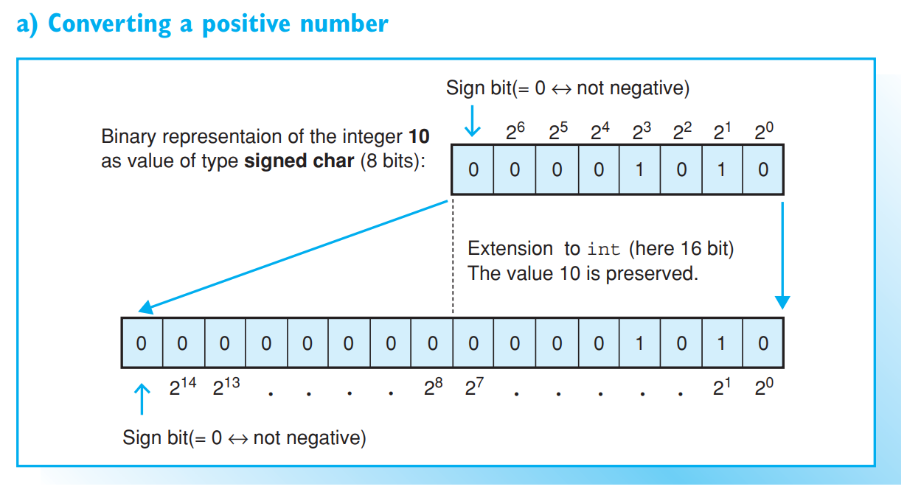
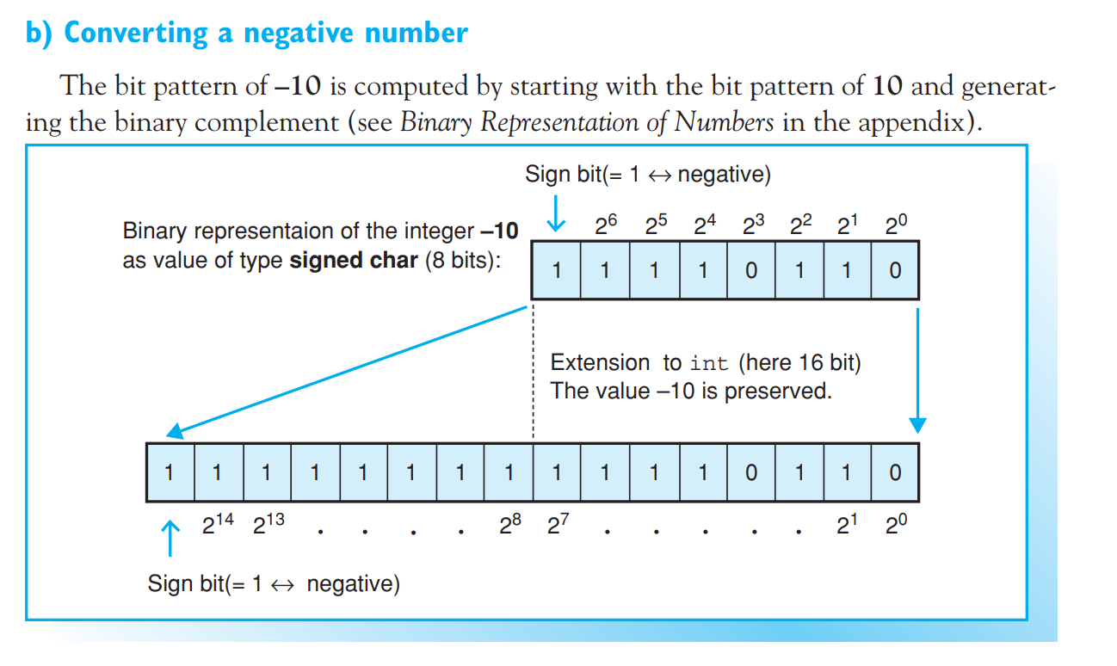
PERFORMING USUAL ARITHMETIC TYPE CONVERSIONS
Converting signed integers

Slide 6
Performing usual arithmetic type conversions
Usual arithmetic type conversions retain the value of a number provided it can be represented by the new type. The procedure for type conversion depends on the types involved:
1. Conversion of an unsigned type to a larger integral type
Examples: unsigned char to int or unsigned int
Zero extension is performed first. During this process, the bit pattern of the number to be converted is expanded to match the length of the new type by adding zeros from the left.

Slide 7
Performing usual arithmetic type conversions
2. Conversion of a signed type to a larger integral type
The new type is also signed
Examples: char to int, short to long
Signed integers are represented by generating the binary complement. The value is retained by performing sign extension. The original bit pattern is expanded to match the length of the new type by padding the sign bit from the left.
The new type is unsigned
Examples: char to unsigned int, long to unsigned long
In this case the value of negative numbers is not retained. If the new type is of the same length, the bit pattern is retained. However, the bit pattern will be interpreted differently. The sign bit loses its significance. If the new type is longer, sign extension is performed first and the new bit pattern is then interpreted as unsigned

Slide 8
Performing usual arithmetic type conversions
3. Conversion of an integral type to a floating-point type
Examples: int to double, unsigned long to float
The number is converted to an exponential floating-point type and the value retained. When converting from long or unsigned long to float, some rounding may occur.
4. Conversion of a floating-point type to a larger floating-point type
Examples: float to double, double to long double
The value is retained during this type conversion.

Slide 9
Implicit type conversions in assignments
Arithmetic types can also be mixed in assignments. The compiler adjusts the type of the value on the right of the assignment operator to match the type of the variable on the left.
In the case of compound assignments, calculations using normal arithmetic type conversions are performed first before type conversion is performed following the rule for simple assignments.
EXAMPLE: Multiple examples of type conversions in assignments

Slide 10
Implicit type conversions in assignments
Two different cases can occur during type conversion in assignments:
1. If the type of the variable is larger than the type of the value to be assigned, the type of the value must be promoted. The rules for usual arithmetic type conversions are applied in this case (see Example 1).

Slide 11
Implicit type conversions in assignments
2. If the type of the value to be assigned is larger, this type must be “demoted.” The following procedures are followed depending on individual circumstances:
A) Conversion of an integral type to a smaller type:
the type is converted to a smaller type by removing the most significant byte(s). The bit pattern that remains will be interpreted as unsigned, if the new type is also unsigned, and as signed in all other cases. The value can only be retained if it can be represented by the new type (see Example 2).
when converting an unsigned type to a signed type of the same scale, the bit pattern is retained and will be interpreted as signed (see Example 3).

Slide 12
Implicit type conversions in assignments
B) Conversion of a floating-point type to an integral type:
The decimal part of the floating-point number is removed. For example, 1.9 converts to the integer 1. Rounding can be achieved by adding 0.5 to a positive floating-point number or subtracting 0.5 from a negative floating-point number. This would allow for converting (1.9 + 0.5) to 2.
If the resulting integer is too large or too small for the new type, the result is unpredictable. This particularly applies to converting negative floating point numbers to unsigned integers (see Example 4).

Slide 13
Implicit type conversions in assignments
C) Conversion of a floating-point type to a smaller type
If the floating-point number falls within the range of the new type, the value will be retained, although the accuracy may be compromised.
If the value is too large to be represented by the new type, the result is unpredictable (see Example 5).

Slide 14
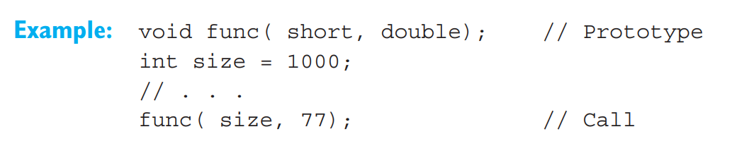
More type conversions Implicit Type Conversions in Function Calls
In the case of function calls, arguments with arithmetic types are converted to the types of the corresponding parameters, similarly to conversions in assignments
The function func() has two parameters belonging to the short and double types. However, the function is called using two int arguments. This leads to implicit conversion of the value of size to short and the integer 77 to double.
When an int is converted to short the compiler issues a warning, since some data loss may occur. You can use explicit type conversion to avoid warnings during type conversion.

Slide 15
Explicit Type Conversion
It is possible to convert the type of an expression explicitly using the cast operator (type).
Syntax: (type) expression
This converts the value of an expression to the given type. Explicit type conversion is also known as casting. The cast operator (type) is a unary operator and thus has a higher precedence than the arithmetic operators.

Slide 16
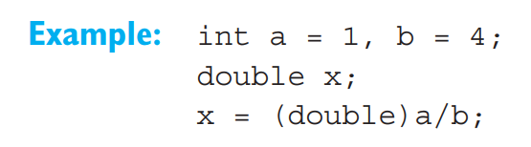
Explicit Type Conversion
In this example the value of a is explicitly converted to a double. Following the conventions of usual implicit type conversion, b is also converted to double and a floatingpoint division is performed. The exact result, 0.25, is assigned to the variable x. Without casting, an integer division with a result of 0 would have occurred.
C++ has additional operators for explicit type conversion—the cast operator "dynamic_cast<>", for example. These operators, which are described in later chapters, are required for special circumstances, for example, to perform type checking at runtime when converting classes

